Slide 1
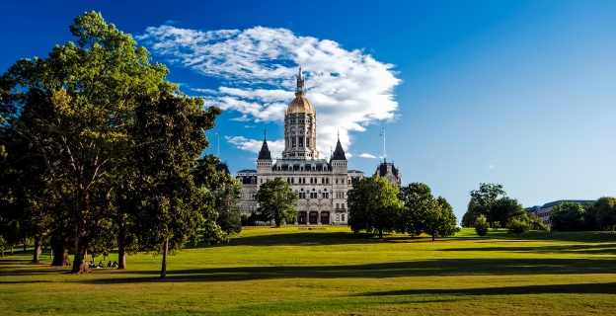
The Body of Christ from across Connecticut is gathering at Bushnell Park in Hartford
on October 16-17.
Please join us!
Celebrating Hope, Love & Healing that Transforms
Details at TruthAlive.today

